Slide 1


Team 10: Smart Irrigation System
Team members: Matthew Eisen, Xavier Garza, Jack Hwang
Sponsor: Dr. John Lusher
TA: Eric Robles

Slide 2
Project Overview
Problem statement: Traditional irrigation systems generally run for a set amount of time at a specific time. This process is completely independent of past, present, and future weather conditions. This can lead to oversaturation and inconvenience the user.

Slide 3
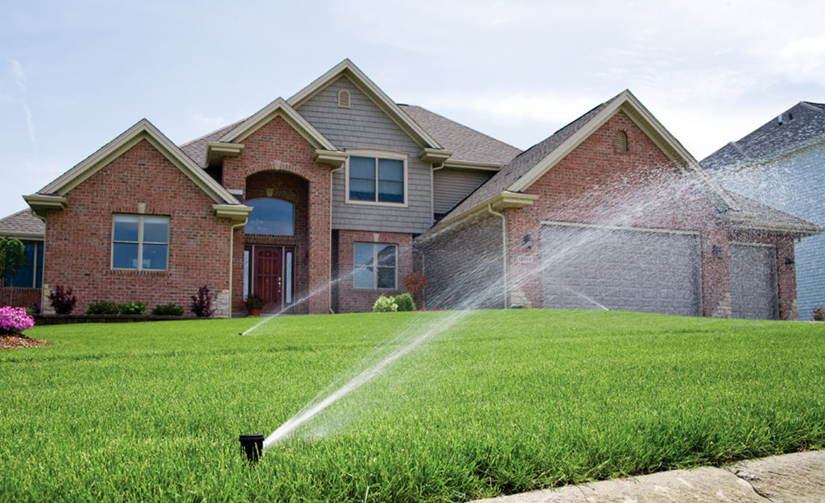
Project Overview
Solution proposal: Design an irrigation system that can track past rainfall as well as read weather forecasts. This system will automatically prevent activation to minimize oversaturation and activate to compliment rainfall when it does not achieve saturation. The system will conserve water and save the user money.

Slide 4
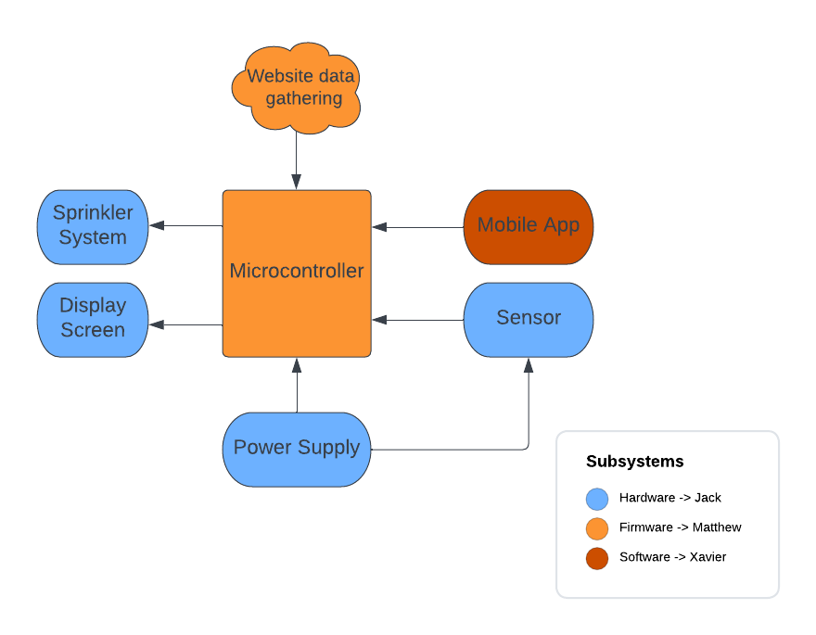
System Overview

Slide 5
Hardware Subsystem
ESP-32 will be utilized for the microcontroller
Low cost to make a power efficient and functional board
WiFi and bluetooth compatibility
Design and Construct PCB
Be able to smoothly support the functionality of the microcontroller
Altium software
Manage power delivery of the system
Microcontroller operates from 2.3 - 3.6 V, 80mA
3.3 Voltage Regulator using LiPo battery for microcontroller
Haven’t completely decided on a specific sensor to utilize

Slide 6
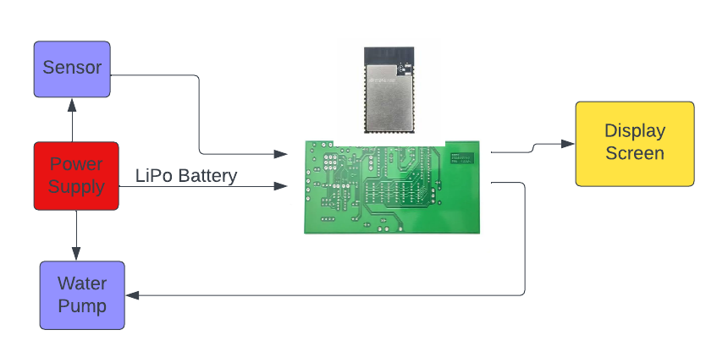
Hardware Subsystem

Slide 7
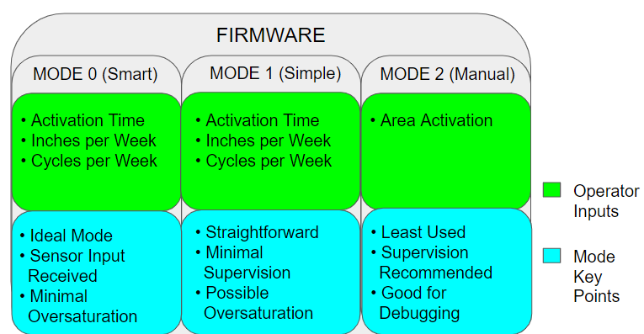
Firmware Subsystem
Prompt user’s desired parameters
Take buttons, sensors, and internet data as inputs
Output data to display and control logic for the sprinkler system
Three distinct operating modes

Slide 8
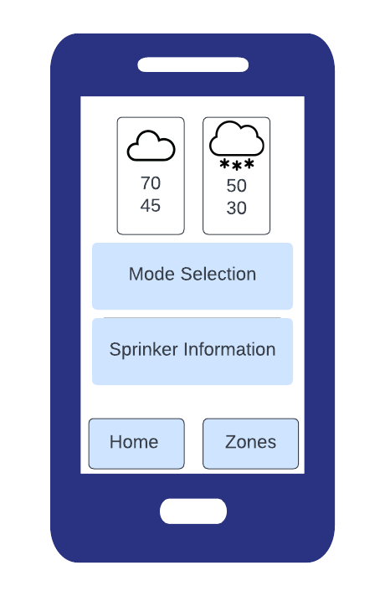
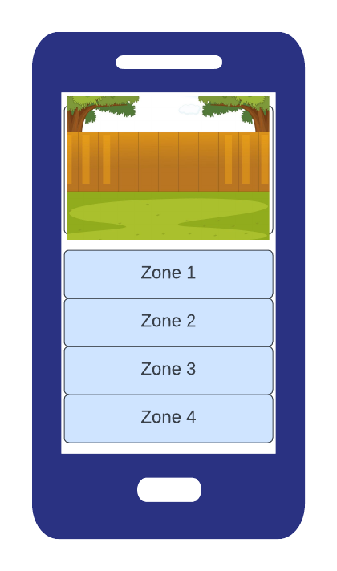
Android App Subsystem
Communicate with the microcontroller via bluetooth
Control system from the app
Setup user preferences
Amount of water per week
Zone creation and selection
Mode selection
Activation time
Cycles per week

Slide 9
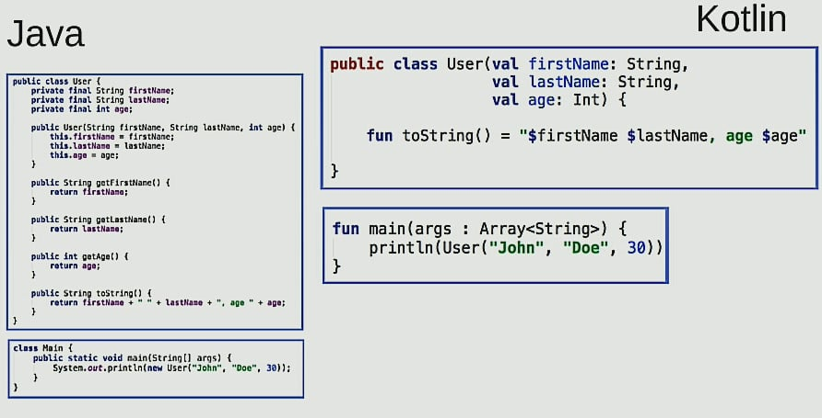
Android App Subsystem
The app will be developed in Android Studio Using Kotlin.
Key Differences with Java and Kotlin:
Java is object oriented, while kotlin is also a functional language
Java libraries can be used in Kotlin
Kotlin eliminates null pointer exceptions, null safety.
Kotlin is less error prone, it doesn’t require semicolons

Slide 10
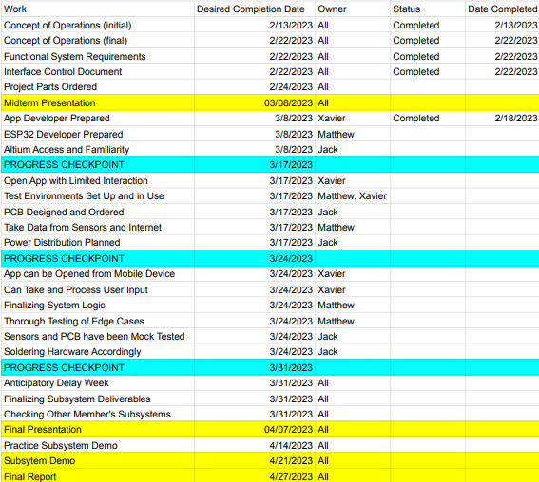
Execution Plan

Slide 11
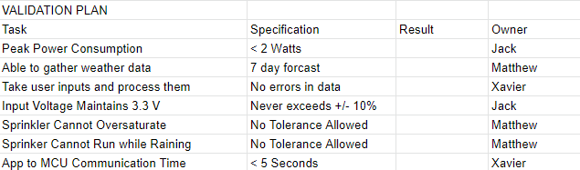
Validation Plan

Slide 12
Thank You!

